Slide 1
Linked Data
In Alma and Primo VE NDE
Yoel Kortick | May 2026

Slide 2
Agenda
Introduction
The Linked Data Info Card and Contributor Page in Alma - MARC21
The Linked Data Info Card and Contributor Page in Primo VE NDE - MARC21
Two examples of BIBFRAME in Alma
  The Linked Data Info Card and Contributor Page in Alma - BIBFRAME – 1
  The Linked Data Info Card and Contributor Page in Alma - BIBFRAME - 2
Two examples of BIBFRAME in Primo VE
  Linked Data Info Card and Contributor Page in Primo VE NDE - BIBFRAME - 1
  Linked Data Info Card and Contributor Page in Primo VE NDE - BIBFRAME – 2
Person information sources and how the match is made
Person information sources and how the match is made for non-LCNAMES headings
The functionality in the “Works” search
The functionality in a member institution of a Network Zone consortium
The functionality using non-preferred terms

Slide 3

Introduction

Slide 4
Introduction
The Linked Data Info Card allows Alma Staff Users to view Linked Data related to headings of a bibliographic record from the results of a Titles search.
The Contributor Page allows Alma Staff Users to view additional Linked Data information from either
  The Linked Data Info Card
  The Metadata Editor “Open Authority headings (F3)” results when viewing a specific authority record

Slide 5
Introduction
End users in Primo VE can
  View the Linked Data Info Card from the full view of the record.
  View the Contributor Page from the link in the Linked Data Info Card.
  View the Contributor Page from the autocomplete heading.

Slide 6
The Linked Data Info Card and Contributor Page in Alma - MARC21

Slide 7
The Linked Data Info Card and Contributor Page in Alma - MARC21
Access to the Linked Data Info Card in Alma is from
  The Summary section of the Titles search results
    For example, for MARC21 records this is the Main Entry 100 field
  The Names section of the Titles search results
    For example, for MARC21 records this is the Main Entry 100 field and the Added Entry 700 field(s)
At the current time the Linked Data Info Card appears for headings linked to the LCNAMES authority vocabulary.
In future releases this will be expanded to other vocabularies.

Slide 8
The Linked Data Info Card and Contributor Page in Alma - MARC21
Let’s take a look at title “The books of Jacob” by Olga Tokarczuk
It has (among other fields)
  A 100 field for “Tokarczuk, Olga” linked to LCNAMES
  A 600 field for “Frank, Jacob” linked to LCNAMES
  A 700 field for “Croft, Jennifer” linked to LCNAMES

Slide 9
The Linked Data Info Card and Contributor Page in Alma - MARC21
Here are the fields which we will see in the Linked Data Info Cards and Contributor pages

Slide 10
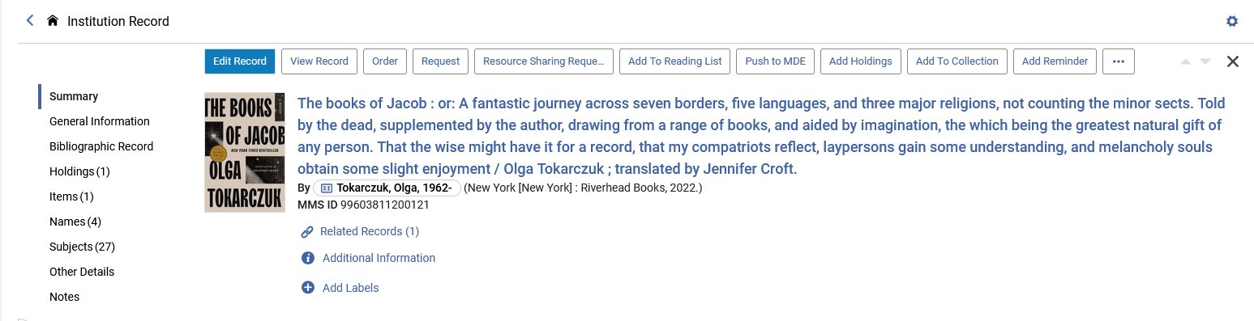
The Linked Data Info Card and Contributor Page in Alma - MARC21
In the Summary Section of the titles search we see the link to the Linked data Info Card for the heading in the 100 field

Slide 11
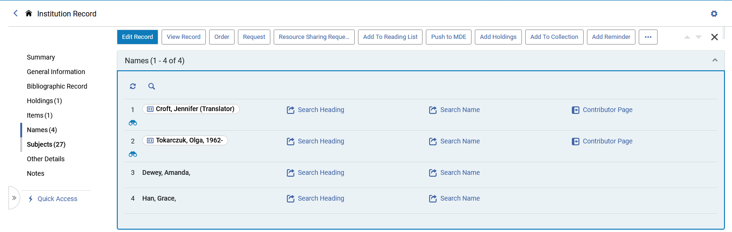
The Linked Data Info Card and Contributor Page in Alma - MARC21
In the Names Section we see the link to the Linked data Info Card for the heading in the 100 field and 600 field.

Slide 12
The Linked Data Info Card and Contributor Page in Alma - MARC21
The link to the Linked Data Info Card works the same from the Summary section and the Names section.
We will focus here on the Names section.

Slide 13
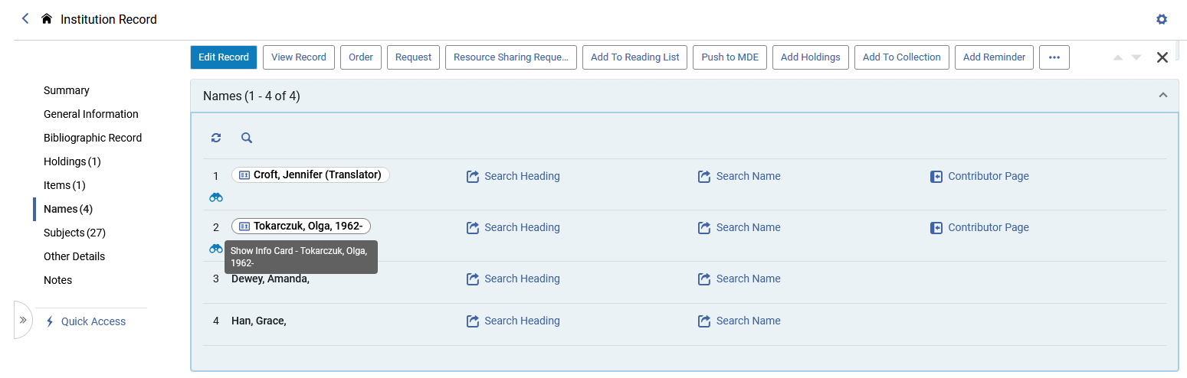
The Linked Data Info Card and Contributor Page in Alma - MARC21
When hovering over the Name for the Linked Data Info Card a pop-up text appears “Show Info Card - [name of heading]”

Slide 14
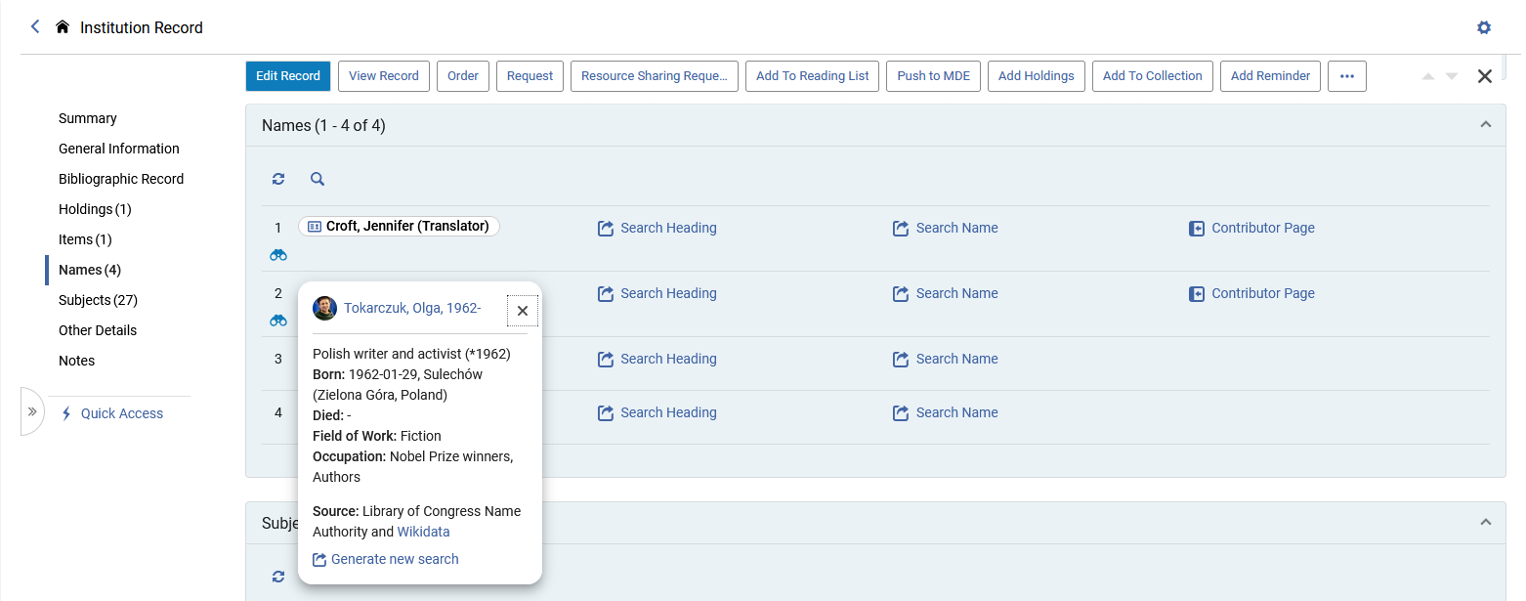
The Linked Data Info Card and Contributor Page in Alma - MARC21
Clicking the name shows information pertaining to the heading, taken from Wikidata and LCNAMES.
Here it is for Tokarczuk, Olga
This is the Linked Data Info Card

Slide 15
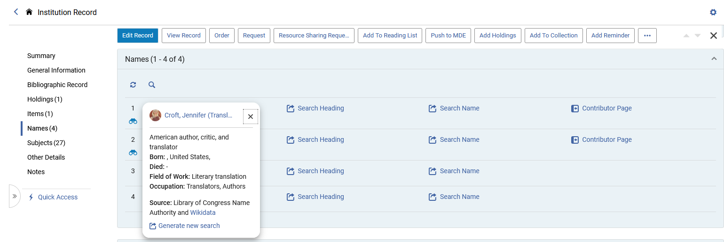
The Linked Data Info Card and Contributor Page in Alma - MARC21
Here is the Linked Data Info Card for “Croft, Jennifer”

Slide 16
The Linked Data Info Card and Contributor Page in Alma - MARC21
We will now click the name link in the Linked Data Info Card for “Tokarczuk, Olga”. This will bring us to the Contributor Page

Slide 17
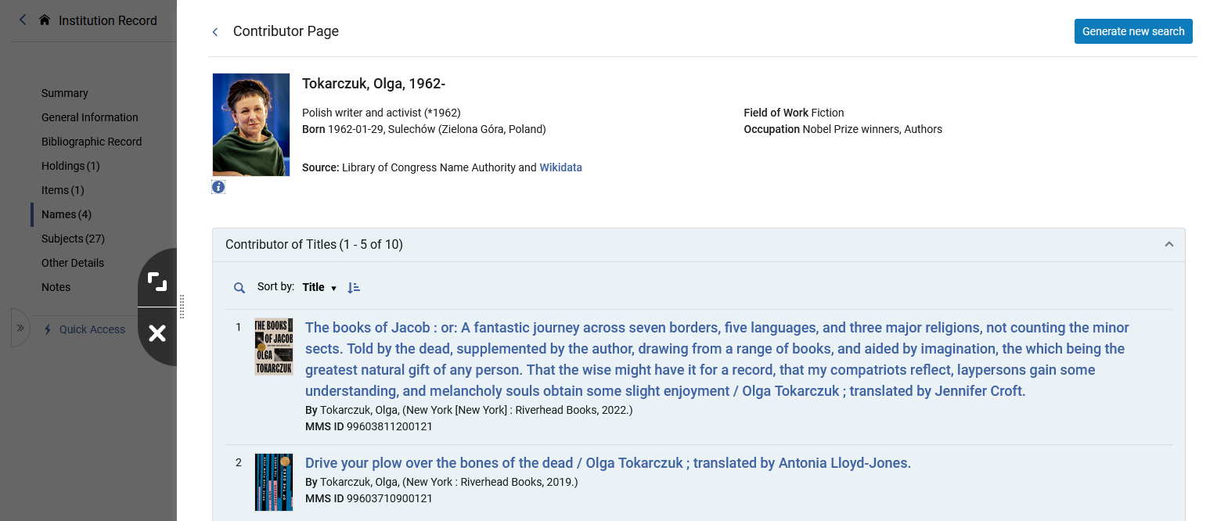
The Linked Data Info Card and Contributor Page in Alma - MARC21
The Contributor Page opens in a slide panel.
It is a combination of data from Library of Congress Name Authority and Wikidata
The Contributor Page also includes a list of titles in the institution for the specific Contributor.

Slide 18
The Linked Data Info Card and Contributor Page in Alma - MARC21
We will now click the Wikidata link in the Linked Data Info Card for “Tokarczuk, Olga”

Slide 19
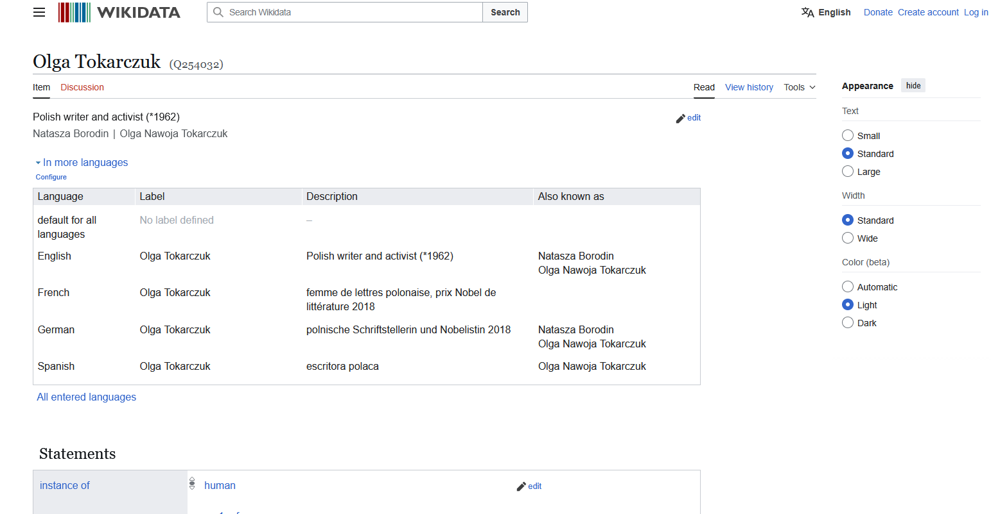
The Linked Data Info Card and Contributor Page in Alma - MARC21
After clicking the Wikidata link a new tab in the browser opens with the relevant entry in Wikidata.
In this case, after clicking the Wikidata link for “Tokarczuk, Olga, we are brought to (in a new tab) https://www.wikidata.org/wiki/Q254032

Slide 20
The Linked Data Info Card and Contributor Page in Alma - MARC21
Now we will click “Contributor Page” for “Tokarczuk, Olga”

Slide 21
The Linked Data Info Card and Contributor Page in Alma - MARC21
The Contributor Page opens in a slide panel.
It is a combination of data from Library of Congress Name Authority and Wikidata
The Contributor Page also includes a list of titles in the institution for the specific Contributor.

Slide 22
The Linked Data Info Card and Contributor Page in Alma - MARC21
Clicking the Wikidata link here will also open a new tab in the browser with the relevant entry in Wikidata, as was the case when we clicked the Wikidata link from the Linked Data Info Card.

Slide 23
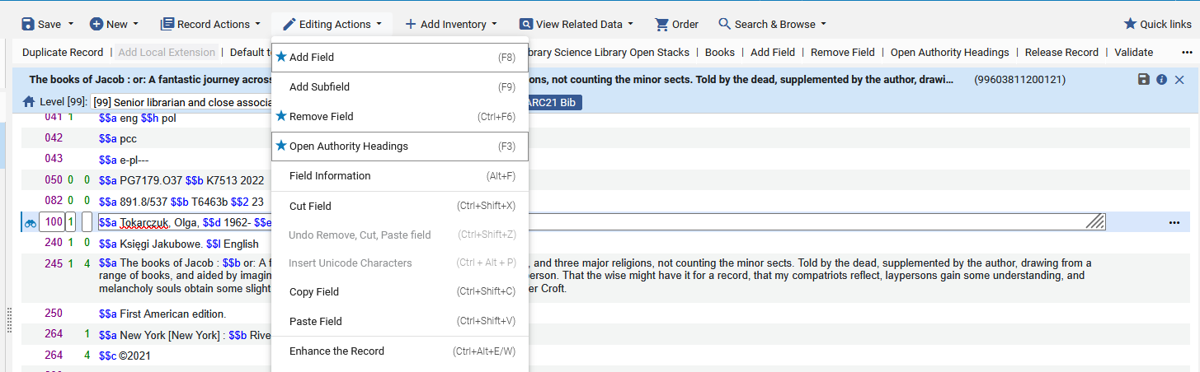
The Linked Data Info Card and Contributor Page in Alma - MARC21
The Contributor Page can also be accessed from the Metadata Editor after doing “Open Authority Headings (F3)” and then viewing a heading

Slide 24
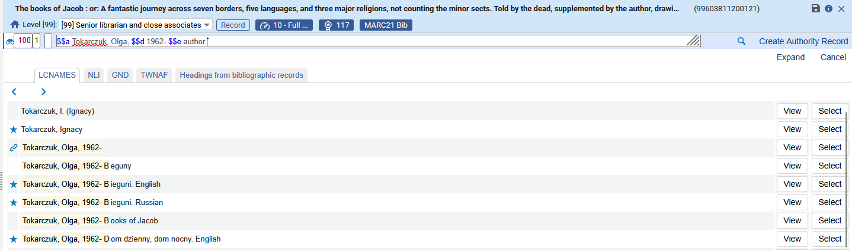
The Linked Data Info Card and Contributor Page in Alma - MARC21
Now we will view the heading

Slide 25
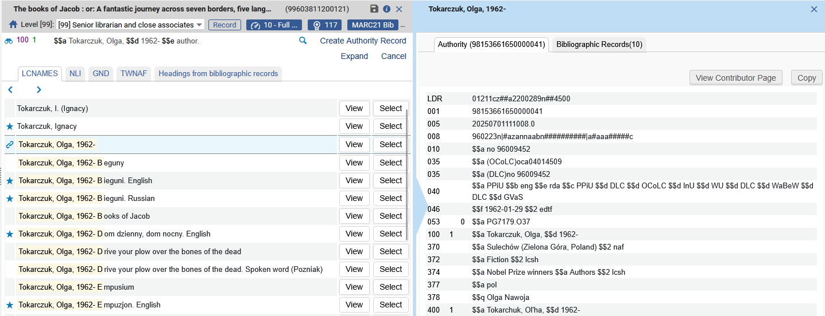
The Linked Data Info Card and Contributor Page in Alma - MARC21
While viewing the authority record, we can click to “View Contributor Page”

Slide 26
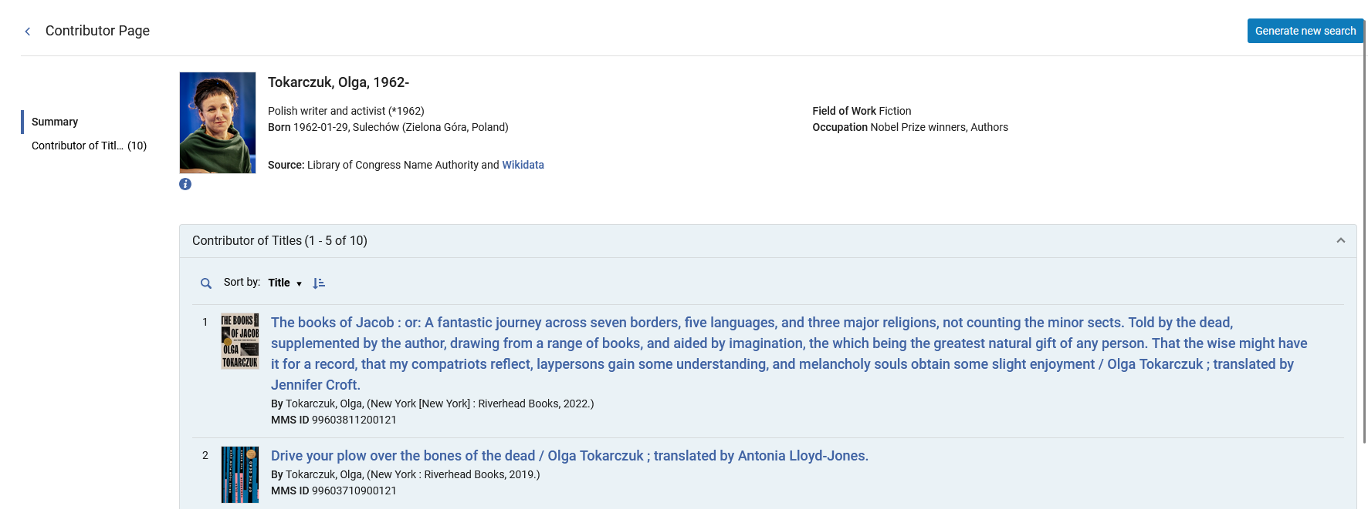
The Linked Data Info Card and Contributor Page in Alma - MARC21
The “Contributor Page” opens
This will bring us back to where we were in the Metadata Editor

Slide 27
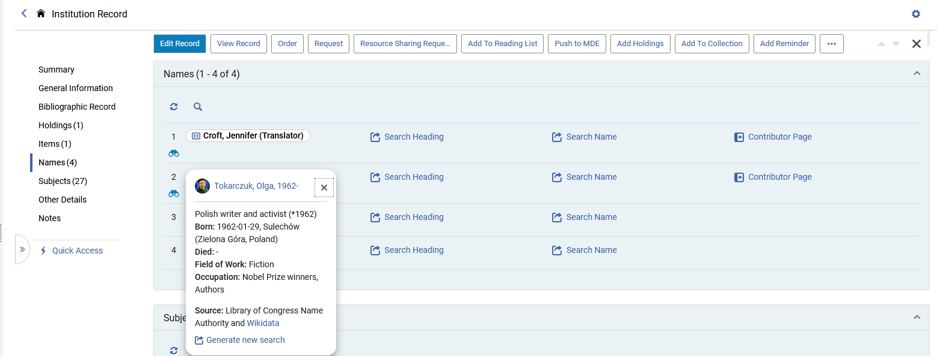
The Linked Data Info Card and Contributor Page in Alma - MARC21
The “Generate New Search” link can be accessed from
The “Linked Data Info Card” which opens after clicking the name of the heading
The “Contributor page”
Here it is from the Linked Data Info Card

Slide 28
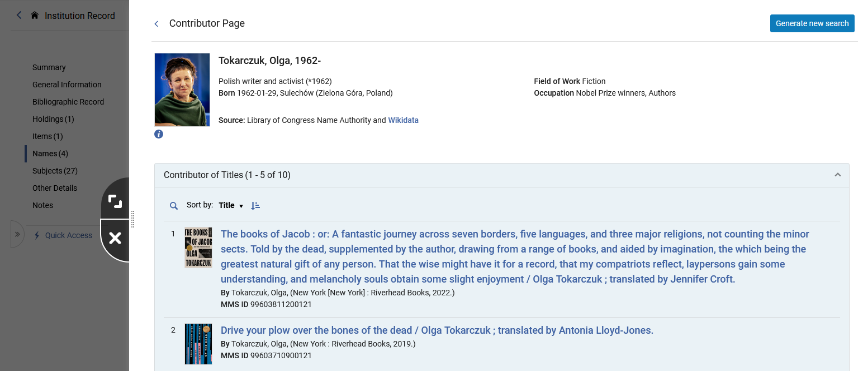
The Linked Data Info Card and Contributor Page in Alma - MARC21
The “Generate New Search” link can be accessed from
The “Linked Data Info Card” which opens after clicking the name of the heading
The “Contributor page”
Here it is from the Contributor Page

Slide 29
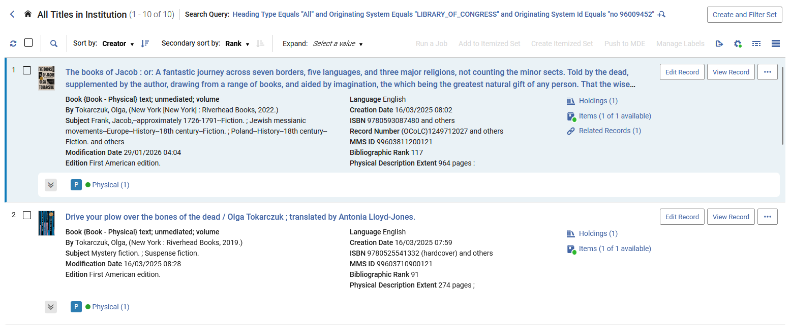
The Linked Data Info Card and Contributor Page in Alma - MARC21
After clicking “Generate new search” A new search is executed in the institution based on the Authority ID (and not on the text of the name)

Slide 30
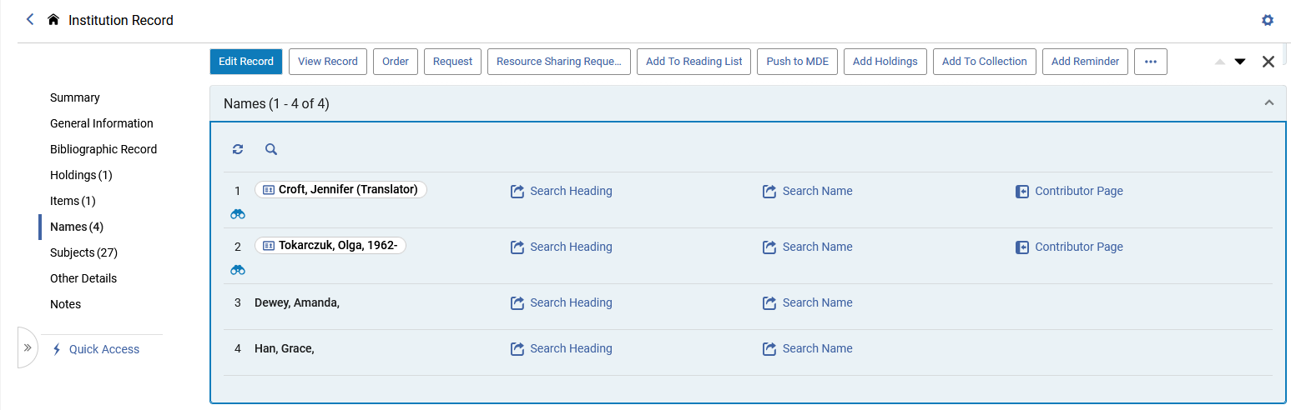
The Linked Data Info Card and Contributor Page in Alma - MARC21
While it is not specifically related to the Linked data Info Card, note also that clicking the binoculars will display the linked authority record in a slide panel
We will now click the binoculars for “Tokarczuk, Olga”

Slide 31
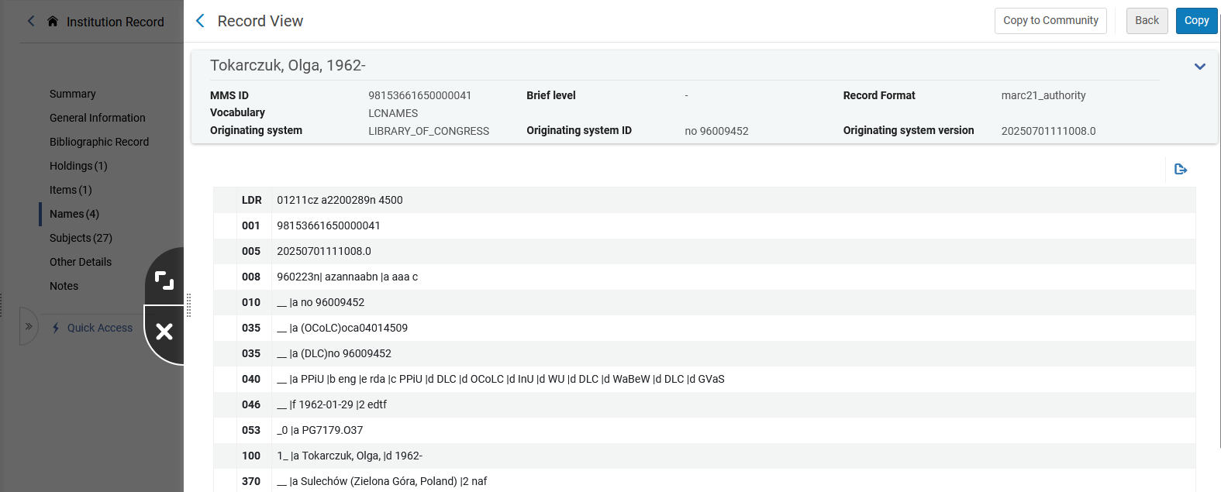
The Linked Data Info Card and Contributor Page in Alma - MARC21
The linked authority record for contributor “Tokarczuk, Olga” has opened in a slide panel

Slide 32
The Linked Data Info Card and Contributor Page in Primo VE NDE - MARC21

Slide 33
The Linked Data Info Card and Contributor Page in Primo VE NDE - MARC21
We will now look at the following in Primo VE NDE:
  The “Autocomplete” for Linked Data headings
  The Linked Data Info Card (sometimes referred to as the “Person Info Card” for Primo VE NDE)
  The Contributor Page (sometimes referred to as the “Person Page” for Primo VE NDE)

Slide 34
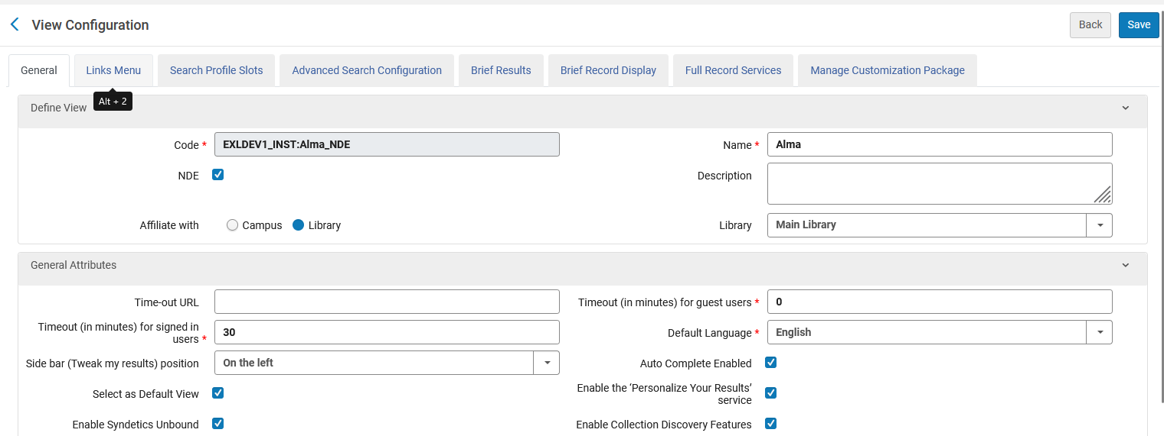
The Linked Data Info Card and Contributor Page in Primo VE NDE - MARC21
The “autocomplete” is enabled in the Primo VE View configurations: “Discovery > Display Configuration > Configure Views > Edit View > ‘General’”. This defines the autocomplete on the level of the specific view.

Slide 35
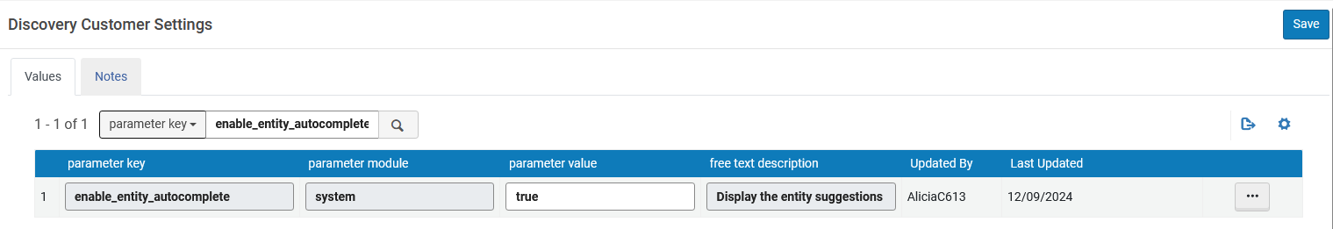
The Linked Data Info Card and Contributor Page in Primo VE NDE - MARC21
The “autocomplete” can also be configured on the institution level, in which case all views will automatically have the autocomplete enable enabled.
To enable the autocomplete set enable_entity_autocomplete to “true” at “Configuration > Discovery > Other > Customer Settings”
To enable the autocomplete differently per view, set the above parameters to false and set their respective parameters to true on the View Configuration page.

Slide 36
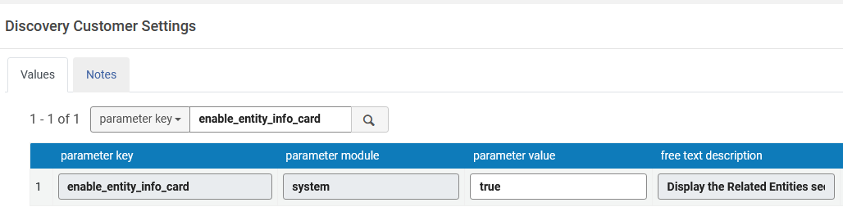
The Linked Data Info Card and Contributor Page in Primo VE NDE - MARC21
To enable the Person Info Card on the Full Display page set enable_entity_info_card to “true” at “Configuration > Discovery > Other > Customer Settings”

Slide 37
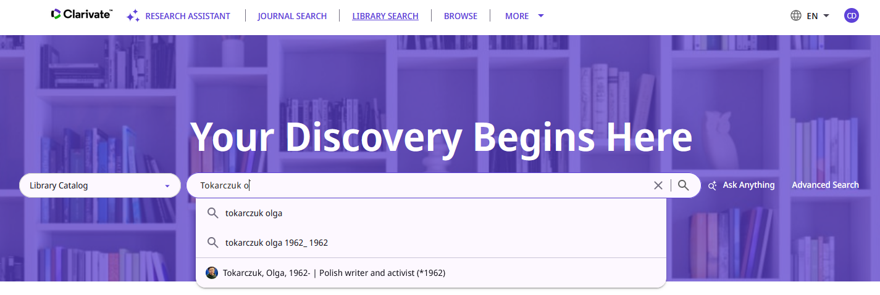
The Linked Data Info Card and Contributor Page in Primo VE NDE - MARC21
When searching a heading in Primo VE and the heading has Linked Data there is an autocomplete
We began searching for “Tokarczuk, O” (the beginning of “Tokarczuk, Olga”)
These are the autocomplete results for Linked Data
We will click here

Slide 38
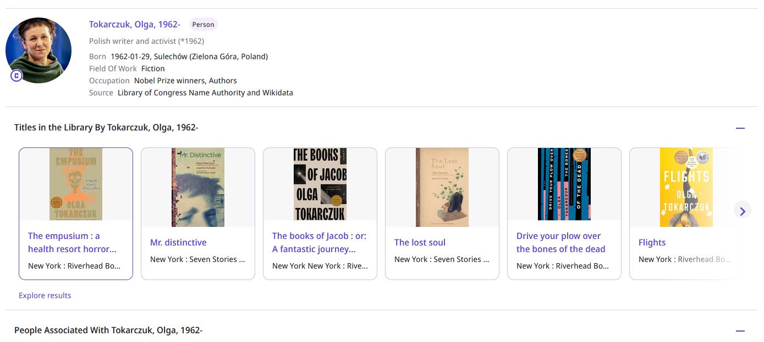
The Linked Data Info Card and Contributor Page in Primo VE NDE - MARC21
After clicking the heading from the autocomplete we arrive to the Contributor Page in Primo VE NDE.
We will talk more about this page very soon, as we will see that we can also arrive here from the Linked Data Info Card in Primo VE NDE.
For now, suffice to say that we can arrive to the Contributor Page in Primo VE NDE from the auto-complete results.

Slide 39
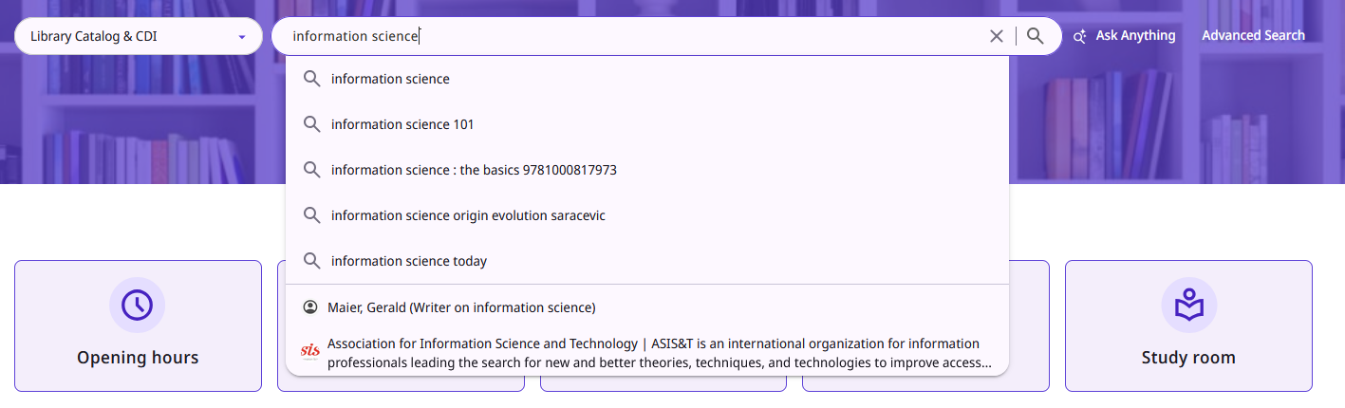
The Linked Data Info Card and Contributor Page in Primo VE NDE - MARC21
Here is another example showing that when searching a heading in Primo VE and the heading has Linked Data there is an autocomplete
We began searching for “information science”
These are the autocomplete results for Linked Data
We will click here

Slide 40
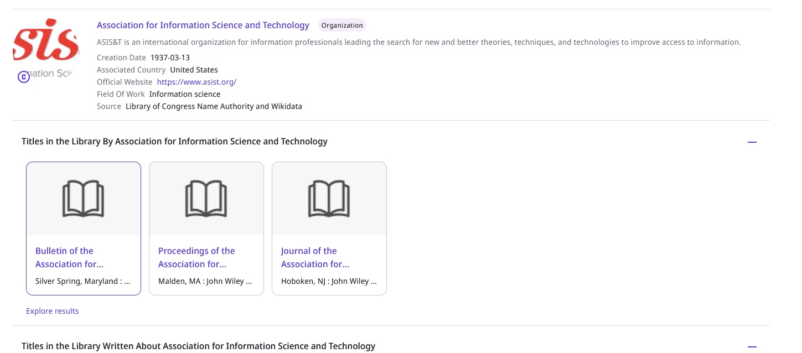
The Linked Data Info Card and Contributor Page in Primo VE NDE - MARC21
After clicking the heading from the autocomplete we arrive to the Contributor Page in Primo VE NDE.
We will talk more about this page very soon, as we will see that we can also arrive here from the Linked Data Info Card in Primo VE NDE.
For now, suffice to say that we can arrive to the Contributor Page in Primo VE NDE from the auto-complete results.

Slide 41
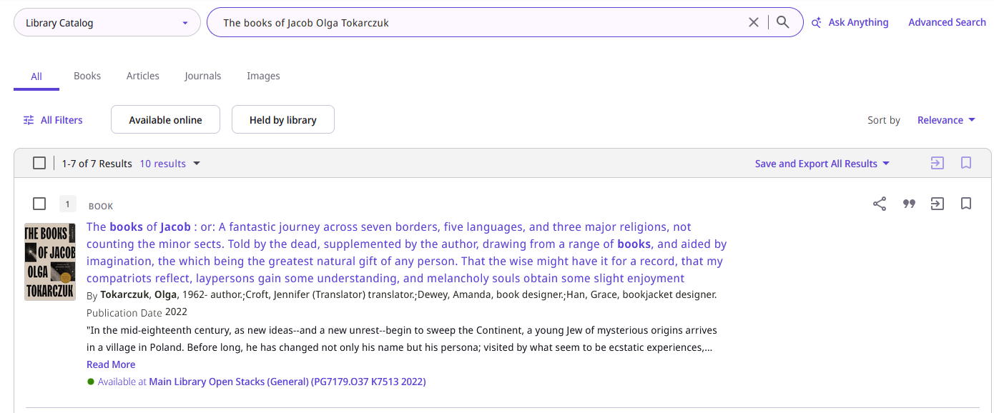
The Linked Data Info Card and Contributor Page in Primo VE NDE - MARC21
We will now search Primo VE NDE for title “The books of Jacob” by Olga Tokarczuk
We will click the title to access the full view of the record

Slide 42
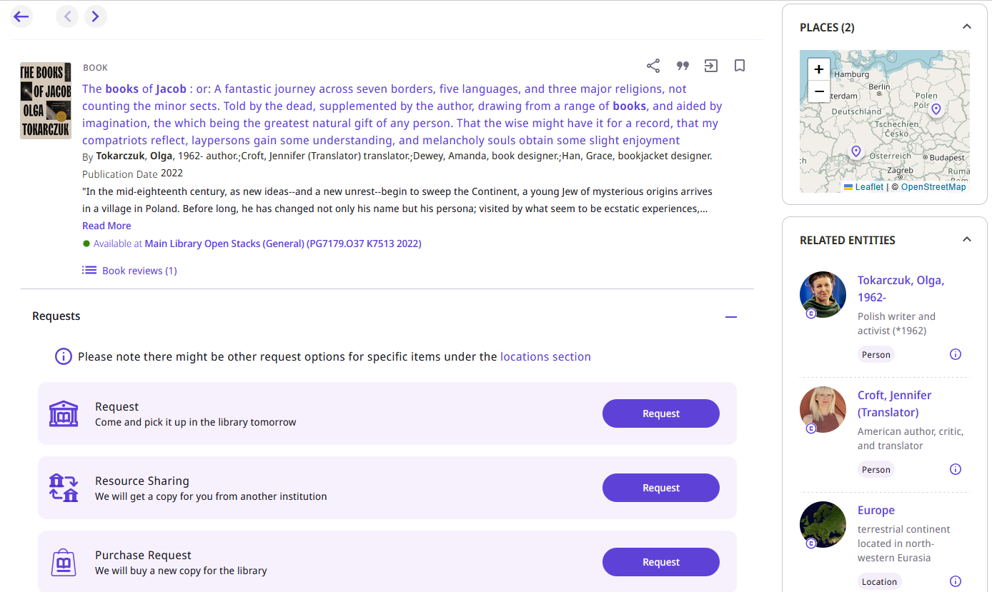
The Linked Data Info Card and Contributor Page in Primo VE NDE - MARC21
The Linked Data Info Cards for the record being viewed appear in the right pane
From 100 field
From 700 field
From 651 field

Slide 43
The Linked Data Info Card and Contributor Page in Primo VE NDE - MARC21
We will now click on a name from the Linked Data Info Card for “Croft, Jennifer (Translator)”

Slide 44
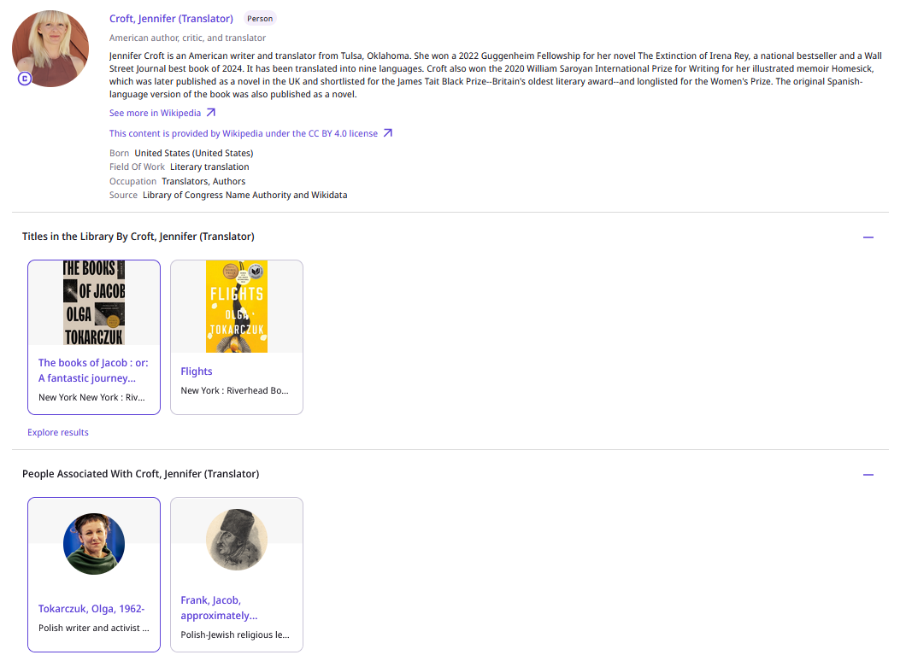
The Linked Data Info Card and Contributor Page in Primo VE NDE - MARC21
After clicking the name in the Linked Data Info Card, the Contributor Page opens with a link to Wikipedia
Link to Wikipedia
Additional titles in the institution by the same person
People in the institution associated with the same person

Slide 45
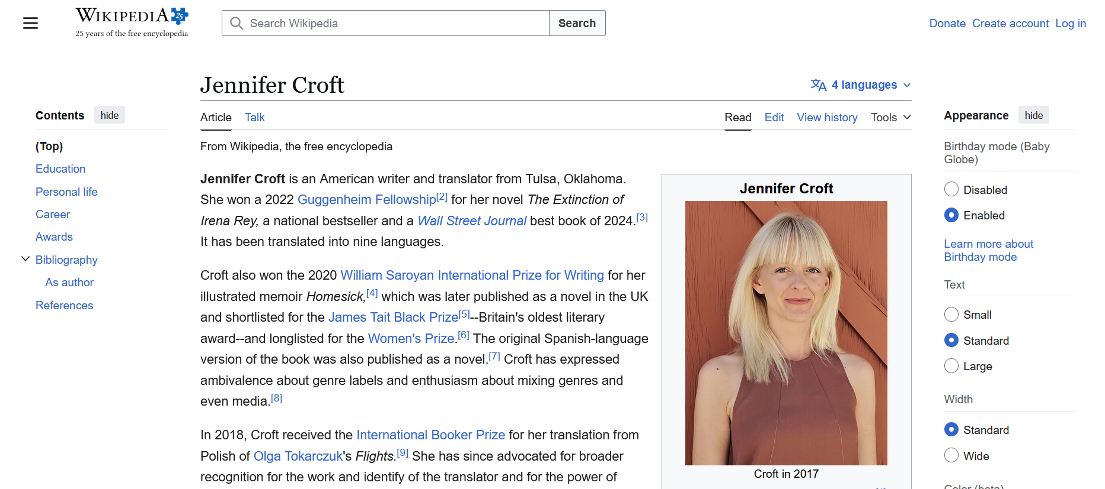
The Linked Data Info Card and Contributor Page in Primo VE NDE - MARC21
After clicking the link to Wikipedia, the Wikipedia entry opens in a new tab

Slide 46
The Linked Data Info Card and Contributor Page in Alma - BIBFRAME - 1

Slide 47
The Linked Data Info Card and Contributor Page in Alma - BIBFRAME - 1
Access to the Linked Data Info Card is from
  The Summary section of the Titles search results
  The Names section of the Titles search results
At the current time the Linked Data Info Card appears for headings linked to the LCNAMES authority vocabulary.
In future releases this will be expanded to other vocabularies.

Slide 48
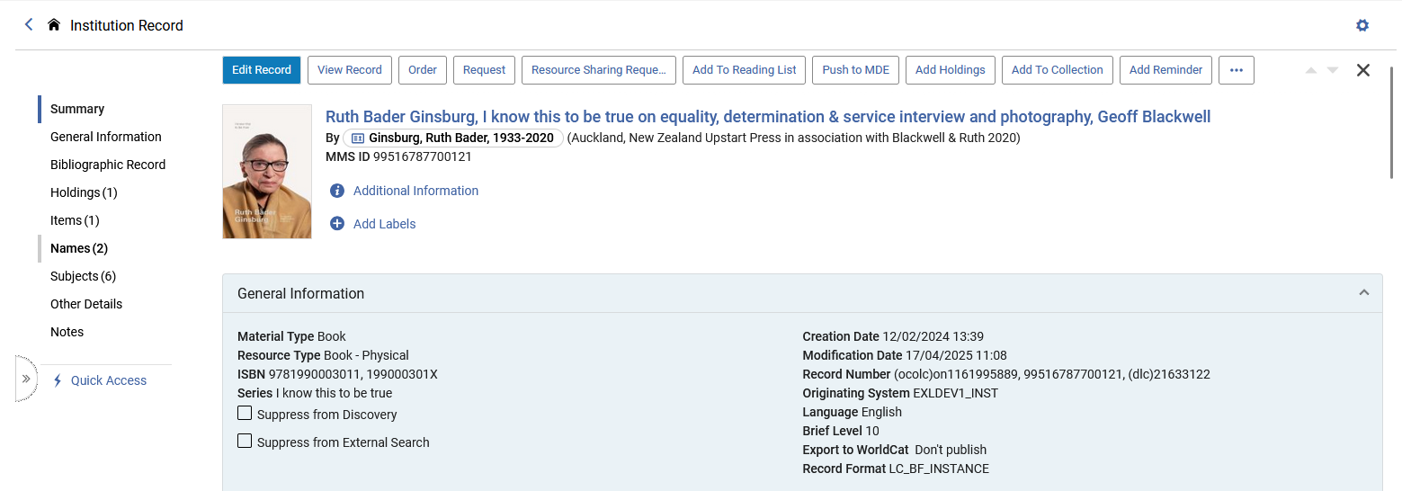
The Linked Data Info Card and Contributor Page in Alma - BIBFRAME - 1
Let’s take a look at title “Ruth Bader Ginsburg, I know this to be true on equality …”.
It is a BIBFRAME INSTANCE

Slide 49
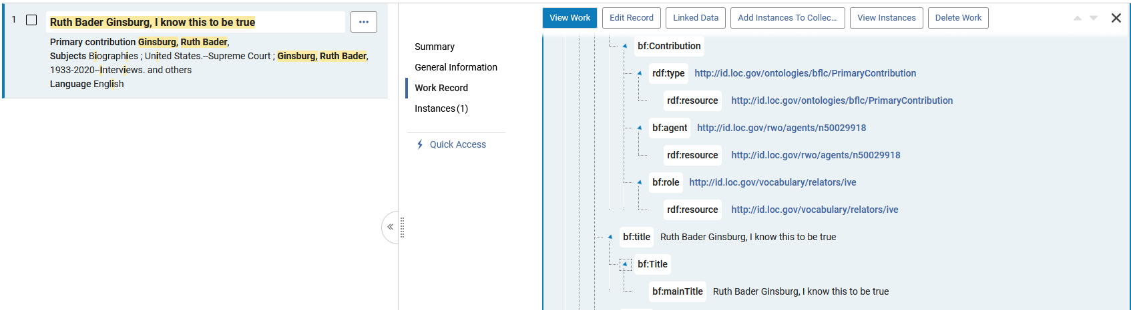
The Linked Data Info Card and Contributor Page in Alma - BIBFRAME - 1
The BIBFRAME WORK has (among other fields): (slide 1 of 2)

Slide 50
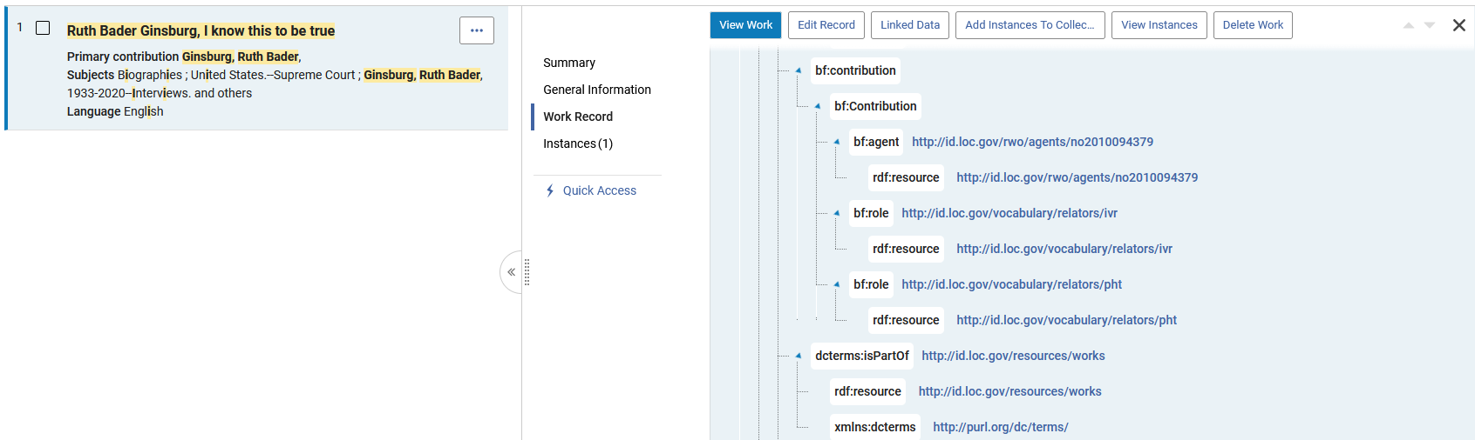
The Linked Data Info Card and Contributor Page in Alma - BIBFRAME - 1
The BIBFRAME WORK has (among other fields): (slide 2 of 2)

Slide 51
The Linked Data Info Card and Contributor Page in Alma - BIBFRAME - 1
Here are the BIBFRAME WORK fields seen on the previous slide:
<bf:contribution>
<bf:Contribution>
<rdf:type rdf:resource="http://id.loc.gov/ontologies/bflc/PrimaryContribution"/>
<bf:agent rdf:resource="http://id.loc.gov/rwo/agents/n50029918"/>
<bf:role rdf:resource="http://id.loc.gov/vocabulary/relators/ive"/>
</bf:Contribution>
</bf:contribution>
…
<bf:contribution>
<bf:Contribution>
<bf:agent rdf:resource="http://id.loc.gov/rwo/agents/no2010094379"/>
<bf:role rdf:resource="http://id.loc.gov/vocabulary/relators/ivr"/>
<bf:role rdf:resource="http://id.loc.gov/vocabulary/relators/pht"/>
</bf:Contribution>
</bf:contribution>
We will now look at these bf:agent URLs

Slide 52
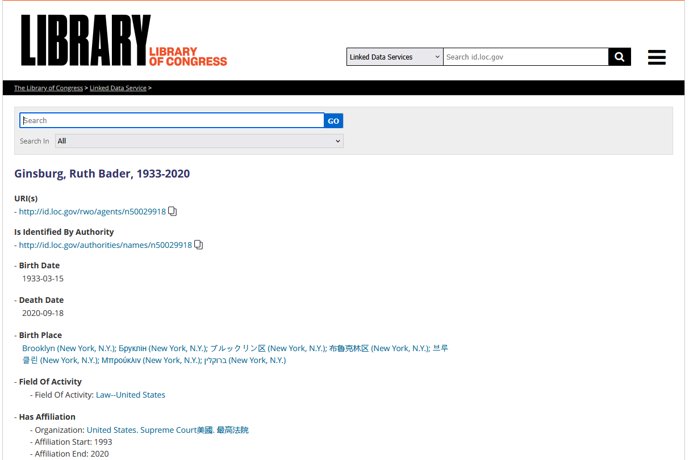
The Linked Data Info Card and Contributor Page in Alma - BIBFRAME - 1
https://id.loc.gov/rwo/agents/n50029918.html

Slide 53
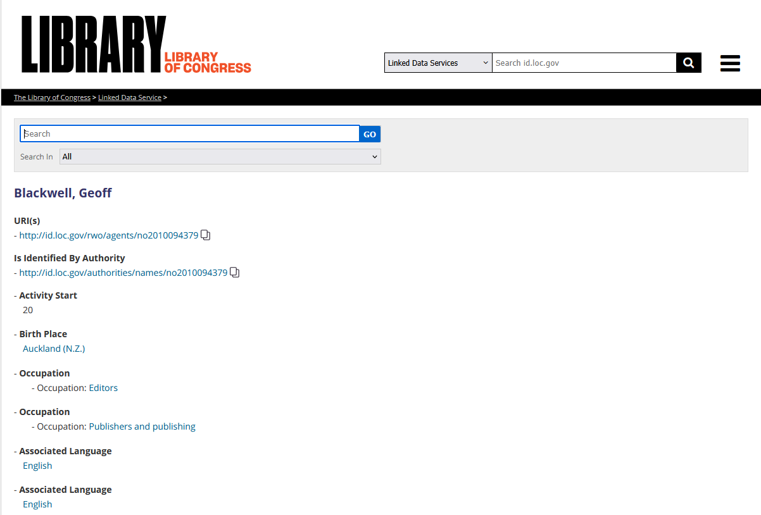
The Linked Data Info Card and Contributor Page in Alma - BIBFRAME - 1
https://id.loc.gov/rwo/agents/no2010094379.html

Slide 54
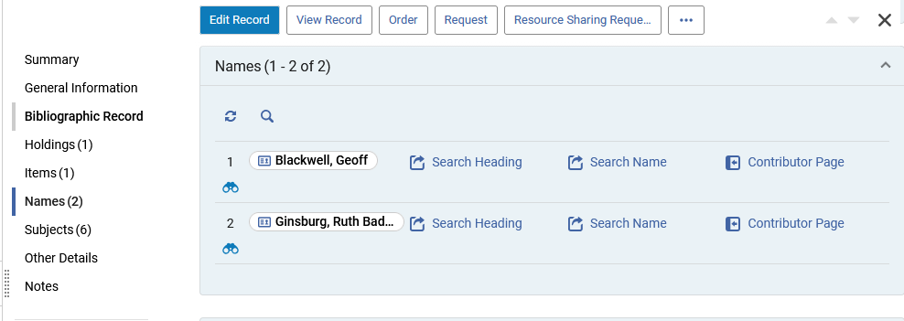
The Linked Data Info Card and Contributor Page in Alma - BIBFRAME - 1
In the Names Section we see the links to the Linked data Info Card for the headings of the names in the bf:agent URLs which we just now saw .

Slide 55
The Linked Data Info Card and Contributor Page in Alma - BIBFRAME - 1
The link to the Linked Data Info Card works the same from the Summary section and the Names section.
We will focus here on the Names section.

Slide 56
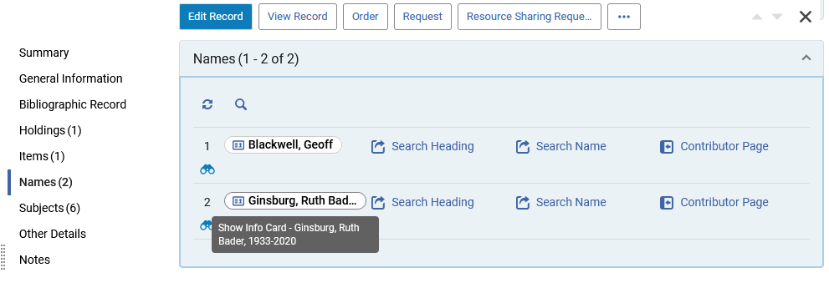
The Linked Data Info Card and Contributor Page in Alma - BIBFRAME - 1
When hovering over the Name for the Linked Data Info Card a pop-up text appears “Show Info Card - [name of heading]”

Slide 57
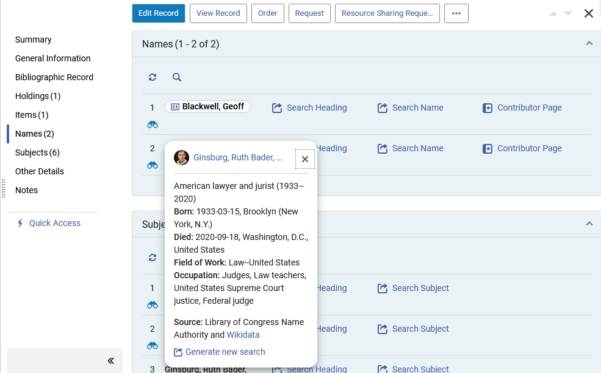
The Linked Data Info Card and Contributor Page in Alma - BIBFRAME - 1
Clicking the name shows information pertaining to the heading, taken from Wikidata and LCNAMES.
Here it is for “Ginsburg, Ruth Bader”.
This is the Linked Data Info Card

Slide 58
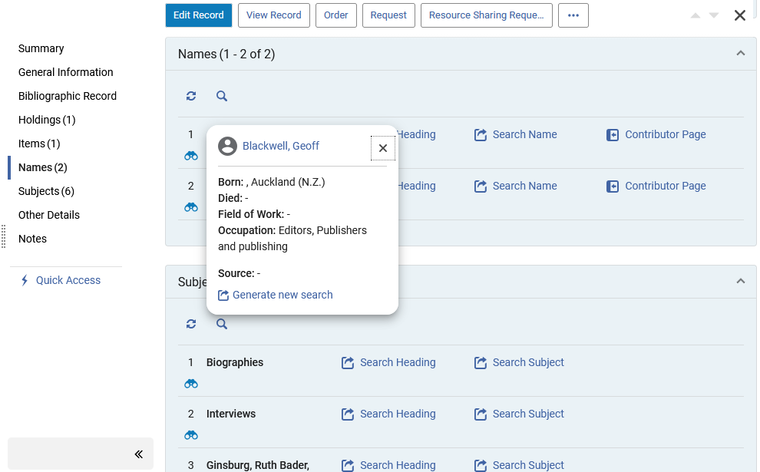
The Linked Data Info Card and Contributor Page in Alma - BIBFRAME - 1
Here is the Linked Data Info Card for “Blackwell, Geoff”

Slide 59
The Linked Data Info Card and Contributor Page in Alma - BIBFRAME - 1
We will now click the Wikidata link in the Linked Data Info Card for “Ginsburg, Ruth Bader”

Slide 60
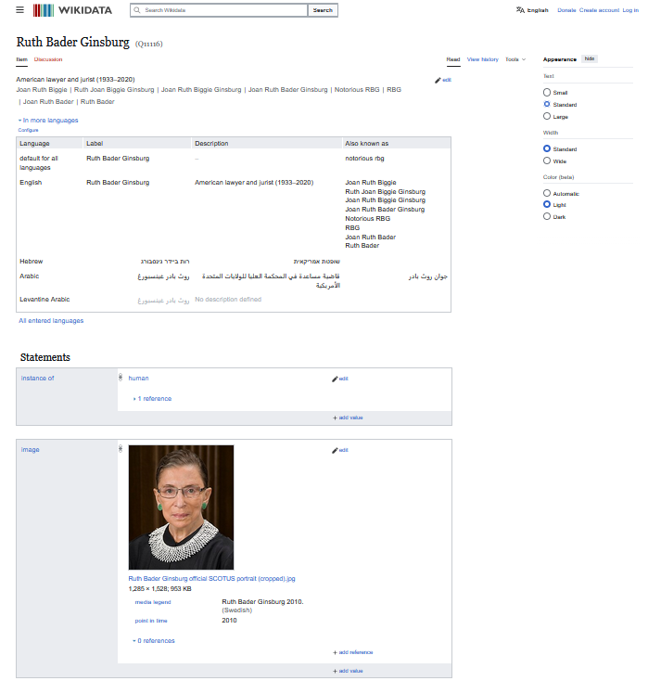
The Linked Data Info Card and Contributor Page in Alma - BIBFRAME - 1
After clicking the Wikidata link a new tab in the browser opens with the relevant entry in Wikidata.
In this case, after clicking the Wikidata link for “Ginsburg, Ruth Bader”, we are brought to (in a new tab) https://www.wikidata.org/wiki/Q11116

Slide 61
The Linked Data Info Card and Contributor Page in Alma - BIBFRAME - 1
Now we will click “Contributor Page” for “Ginsburg, Ruth Bader”

Slide 62
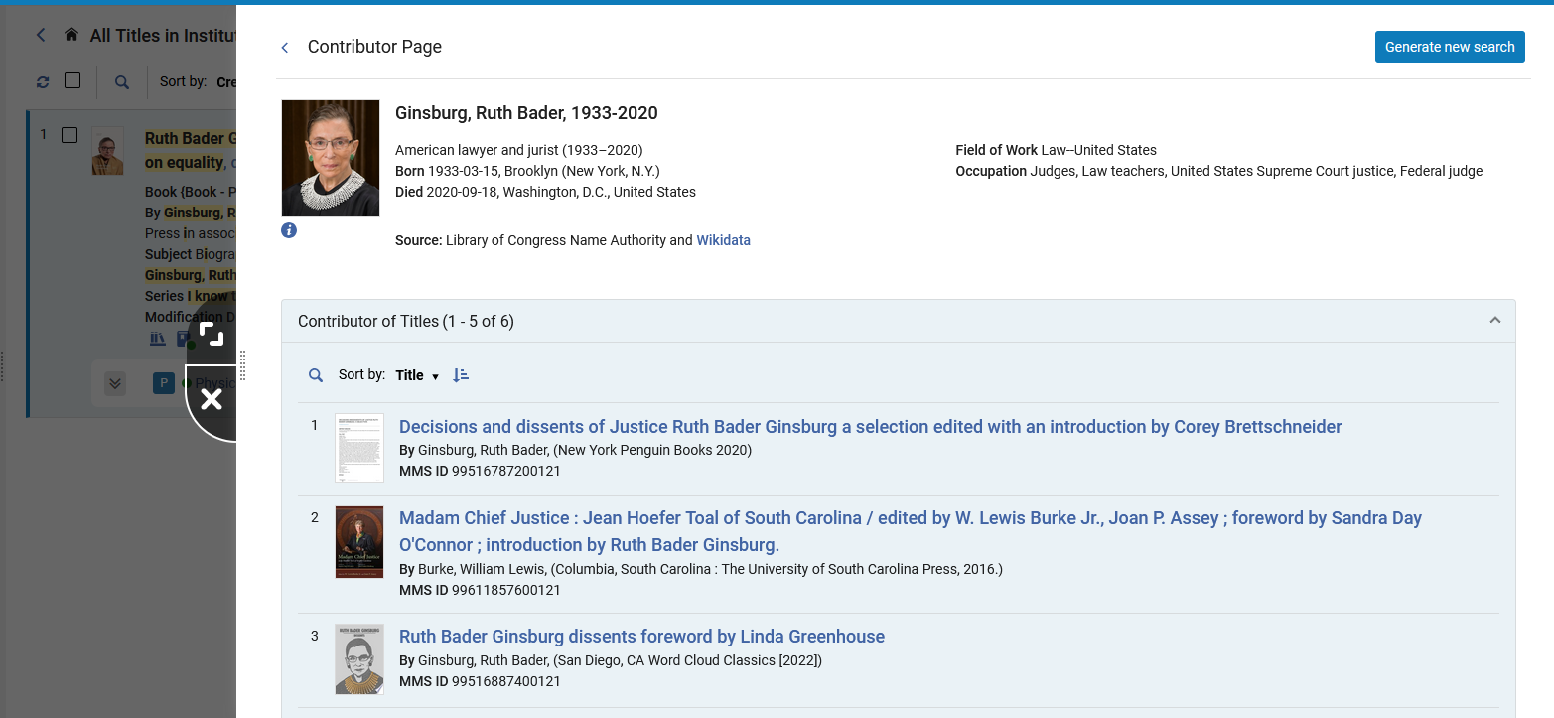
The Linked Data Info Card and Contributor Page in Alma - BIBFRAME - 1
The Contributor Page opens in a slide panel.
It is a combination of data from Library of Congress Name Authority and Wikidata
The Contributor Page also includes a list of titles in the institution for the specific Contributor.

Slide 63
The Linked Data Info Card and Contributor Page in Alma - BIBFRAME - 1
Clicking the Wikidata link here (from the Contributor Page) will also open a new tab in the browser with the relevant entry in Wikidata, as was the case when we clicked the Wikidata link from the Linked Data Info Card.

Slide 64
The Linked Data Info Card and Contributor Page in Alma - BIBFRAME - 1
The “Generate New Search” link can be accessed from
The “Linked Data Info Card” which opens after clicking the name of the heading
The “Contributor page”
Here it is from the Linked Data Info Card

Slide 65
The Linked Data Info Card and Contributor Page in Alma - BIBFRAME - 1
The “Generate New Search” link can be accessed from
The “Linked Data Info Card” which opens after clicking the name of the heading
The “Contributor page”
Here it is from the Contributor Page

Slide 66
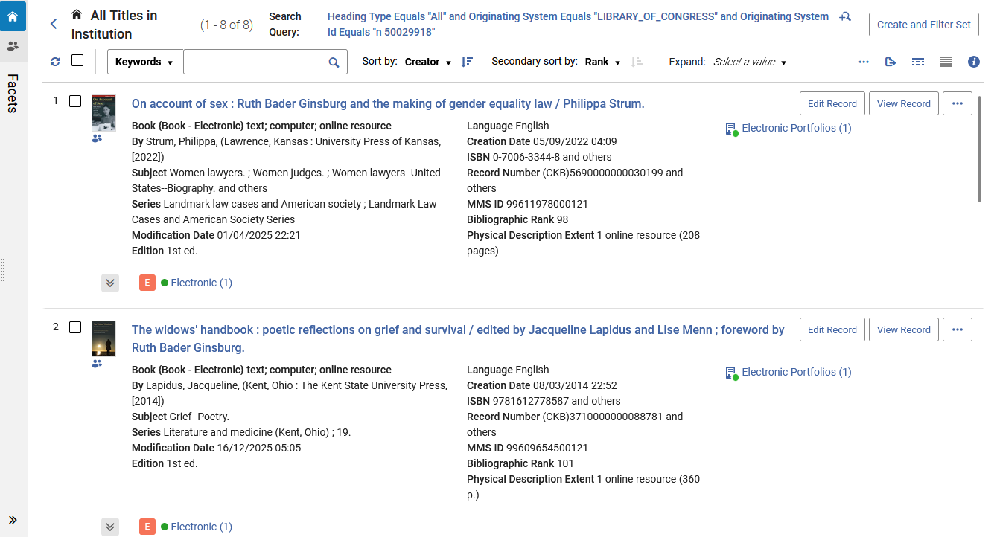
The Linked Data Info Card and Contributor Page in Alma - BIBFRAME - 1
After clicking “Generate new search” A new search is executed in the institution based on the Authority ID (and not on the text of the name)

Slide 67
The Linked Data Info Card and Contributor Page in Alma - BIBFRAME - 2

Slide 68
The Linked Data Info Card and Contributor Page in Alma - BIBFRAME - 2
Access to the Linked Data Info Card is from
  The Summary section of the Titles search results
  The Names section of the Titles search results
At the current time the Linked Data Info Card appears for headings linked to the LCNAMES authority vocabulary.
In future releases this will be expanded to other vocabularies.

Slide 69
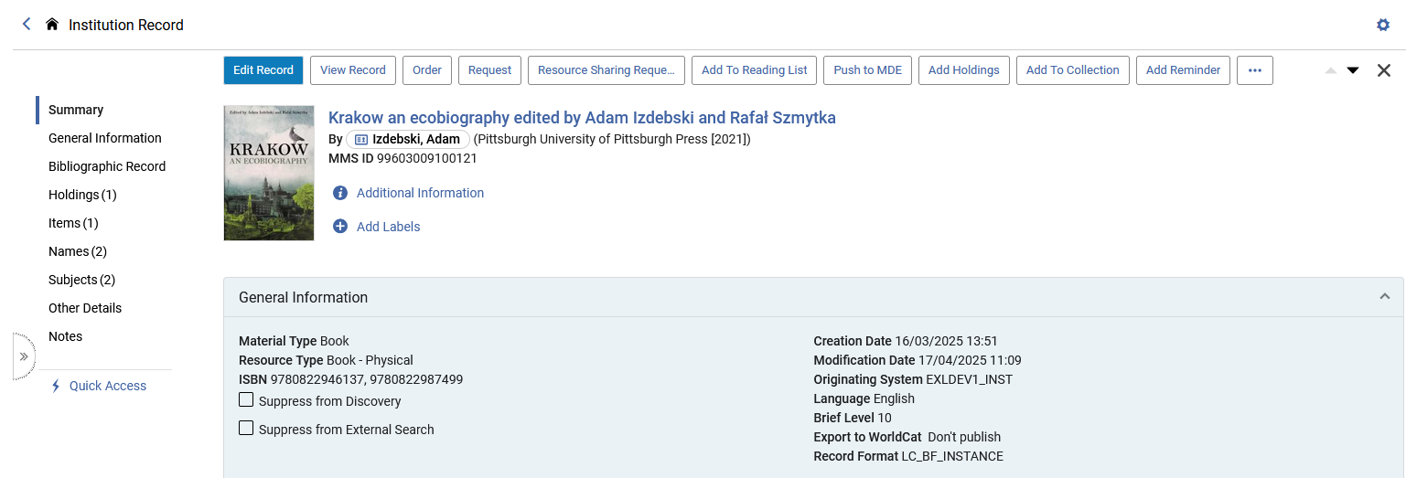
The Linked Data Info Card and Contributor Page in Alma - BIBFRAME - 2
Let’s take a look at title “Krakow an ecobiography” edited by Adam Izdebski and Rafał Szmytka. It is a BIBFRAME INSTANCE

Slide 70
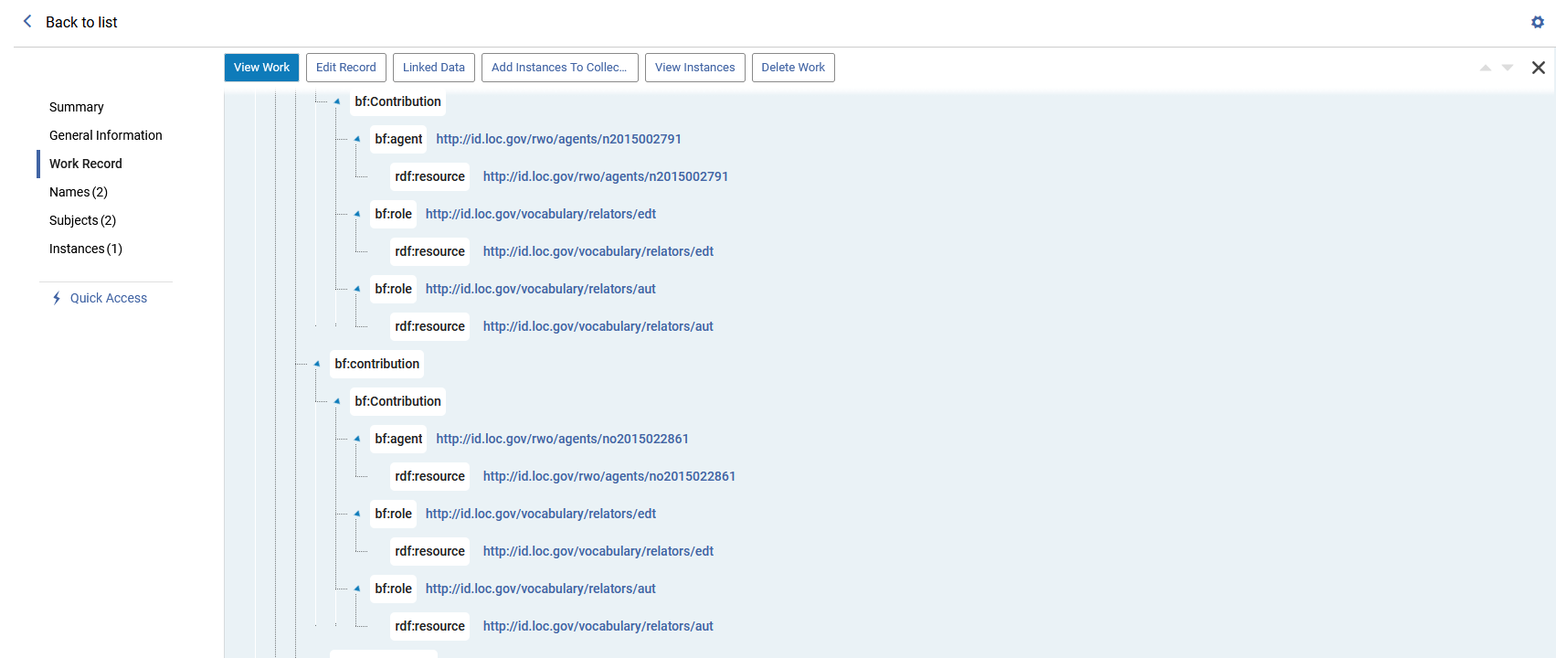
The Linked Data Info Card and Contributor Page in Alma - BIBFRAME - 2
The BIBFRAME WORK has (among other fields):

Slide 71
The Linked Data Info Card and Contributor Page in Alma - BIBFRAME - 2
Here are the BIBFRAME WORK fields seen on the previous slide:
<bf:contribution>
<bf:Contribution>
<bf:agent rdf:resource="http://id.loc.gov/rwo/agents/n2015002791"/>
<bf:role rdf:resource="http://id.loc.gov/vocabulary/relators/edt"/>
<bf:role rdf:resource="http://id.loc.gov/vocabulary/relators/aut"/>
</bf:Contribution>
</bf:contribution>
…
<bf:contribution>
<bf:Contribution>
<bf:agent rdf:resource="http://id.loc.gov/rwo/agents/no2015022861"/>
<bf:role rdf:resource="http://id.loc.gov/vocabulary/relators/edt"/>
<bf:role rdf:resource="http://id.loc.gov/vocabulary/relators/aut"/>
</bf:Contribution>
</bf:contribution>
We will now look at these two bf:agent URLs

Slide 72
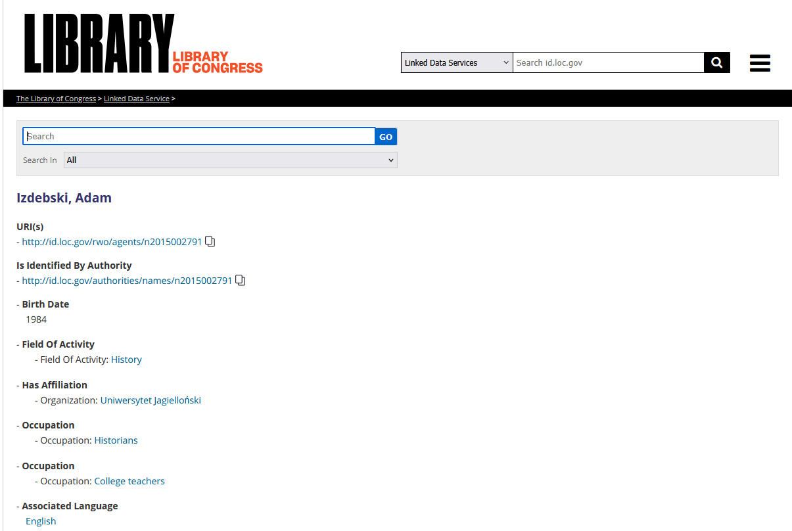
The Linked Data Info Card and Contributor Page in Alma - BIBFRAME - 2
http://id.loc.gov/rwo/agents/n2015002791

Slide 73
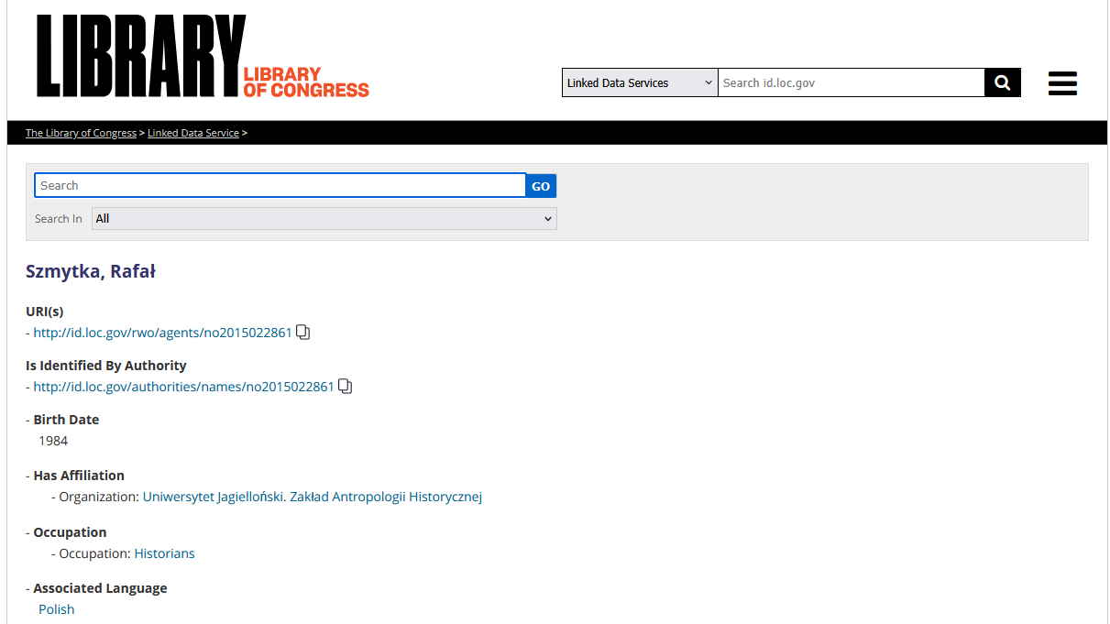
The Linked Data Info Card and Contributor Page in Alma - BIBFRAME - 2
http://id.loc.gov/rwo/agents/no2015022861

Slide 74
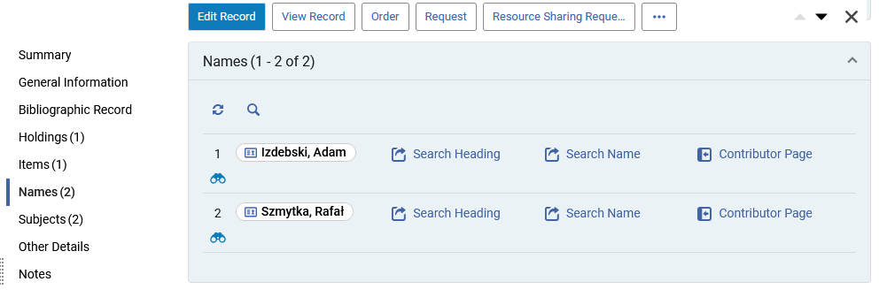
The Linked Data Info Card and Contributor Page in Alma - BIBFRAME - 2
In the Names Section we see the link to the Linked data Info Card for the headings of the names in the bf:agent URLs .

Slide 75
The Linked Data Info Card and Contributor Page in Alma - BIBFRAME - 2
The link to the Linked Data Info Card works the same from the Summary section and the Names section.
We will focus here on the Names section.

Slide 76
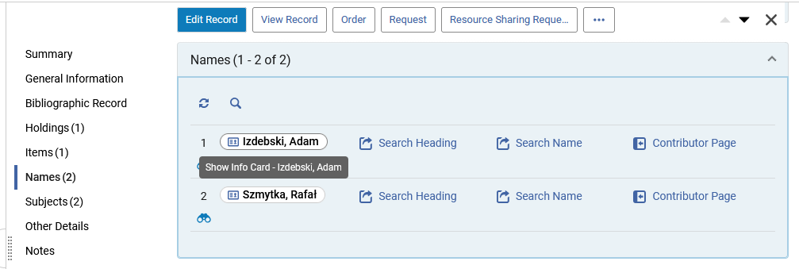
The Linked Data Info Card and Contributor Page in Alma - BIBFRAME - 2
When hovering over the Name for the Linked Data Info Card a pop-up text appears “Show Info Card - [name of heading]”

Slide 77
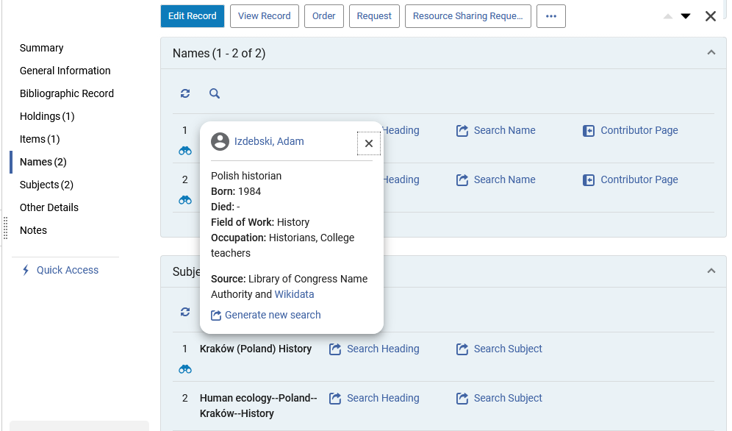
The Linked Data Info Card and Contributor Page in Alma - BIBFRAME - 2
Clicking the name shows information pertaining to the heading, taken from Wikidata and LCNAMES.
Here it is for Izdebski, Adam
This is the Linked Data Info Card

Slide 78
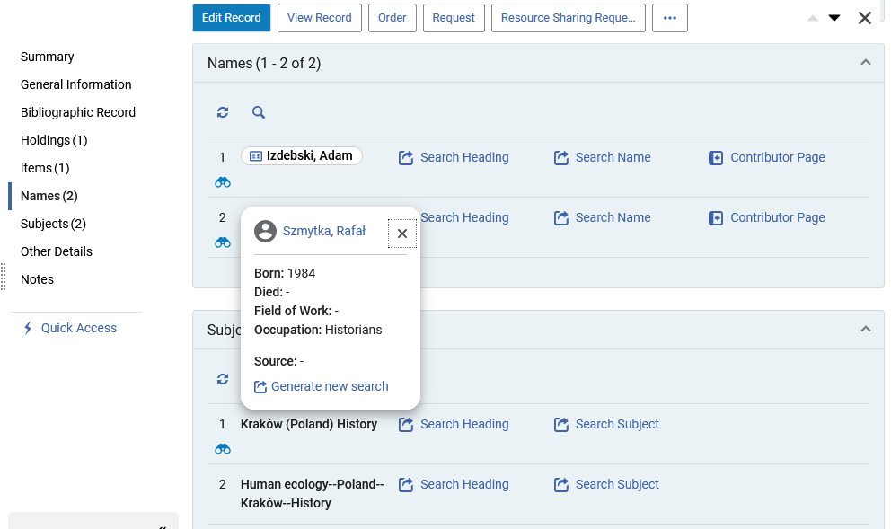
The Linked Data Info Card and Contributor Page in Alma - BIBFRAME - 2
Here is the Linked Data Info Card for “Szmytka, Rafał”

Slide 79
The Linked Data Info Card and Contributor Page in Alma - BIBFRAME - 2
We will now click the Wikidata link in the Linked Data Info Card for “Izdebski, Adam”

Slide 80
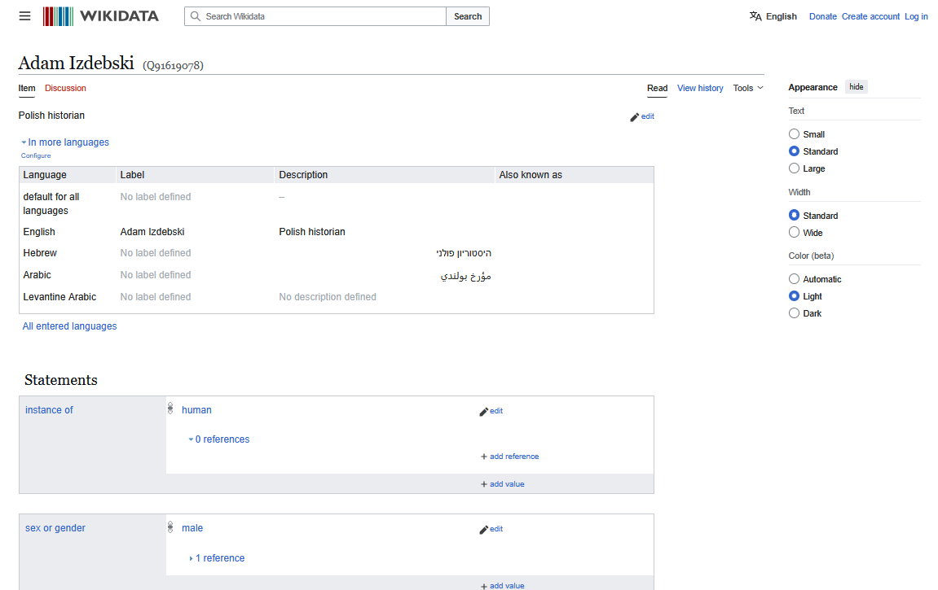
The Linked Data Info Card and Contributor Page in Alma - BIBFRAME - 2
After clicking the Wikidata link a new tab in the browser opens with the relevant entry in Wikidata.
In this case, after clicking the Wikidata link for “Izdebski, Adam", we are brought to (in a new tab) https://www.wikidata.org/wiki/Q91619078

Slide 81
The Linked Data Info Card and Contributor Page in Alma - BIBFRAME - 2
Now we will click “Contributor Page” for “Izdebski, Adam”

Slide 82
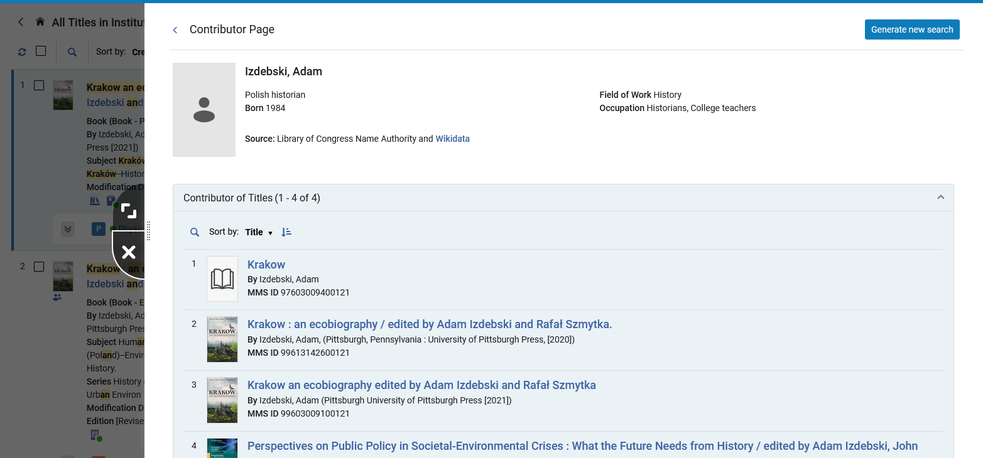
The Linked Data Info Card and Contributor Page in Alma - BIBFRAME - 2
The Contributor Page opens in a slide panel.
It is a combination of data from Library of Congress Name Authority and Wikidata
The Contributor Page also includes a list of titles in the institution for the specific Contributor.

Slide 83
The Linked Data Info Card and Contributor Page in Alma - BIBFRAME - 2
Clicking the Wikidata link here will also open a new tab in the browser with the relevant entry in Wikidata, as was the case when we clicked the Wikidata link from the Linked Data Info Card.

Slide 84
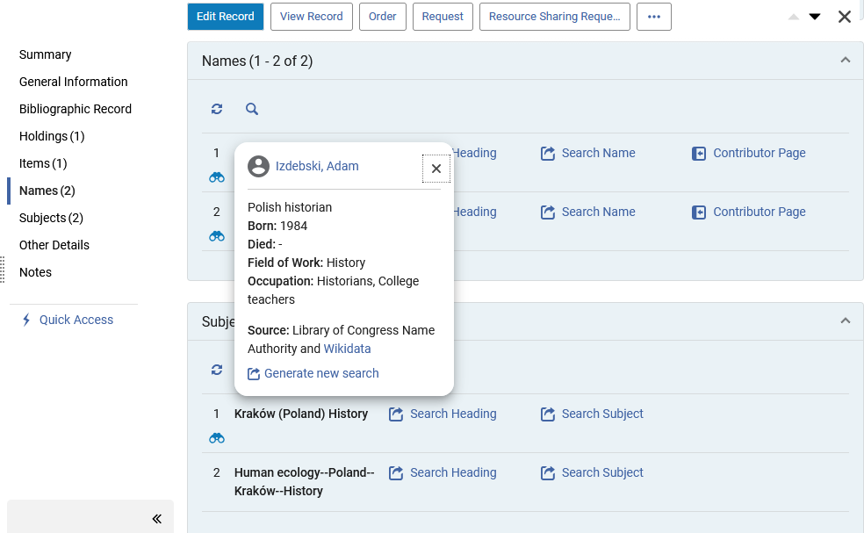
The Linked Data Info Card and Contributor Page in Alma - BIBFRAME - 2
The “Generate New Search” link can be accessed from
The “Linked Data Info Card” which opens after clicking the name of the heading
The “Contributor page”
Here it is from the Linked Data Info Card

Slide 85
The Linked Data Info Card and Contributor Page in Alma - BIBFRAME - 2
The “Generate New Search” link can be accessed from
The “Linked Data Info Card” which opens after clicking the name of the heading
The “Contributor page”
Here it is from the Contributor Page

Slide 86

The Linked Data Info Card and Contributor Page in Alma - BIBFRAME - 2
After clicking “Generate new search” A new search is executed in the institution based on the Authority ID (and not on the text of the name)

Slide 87
Linked Data Info Card and Contributor Page in Primo VE NDE - BIBFRAME - 1

Slide 88
Linked Data Info Card and Contributor Page in Primo VE NDE - BIBFRAME - 1
We will now look at the following in Primo VE NDE:
  The “Autocomplete” for Linked Data headings
  The Linked Data Info Card (sometimes referred to as the “Person Info Card” for Primo VE NDE)
  The Contributor Page (sometimes referred to as the “Person Page” for Primo VE NDE)

Slide 89
Linked Data Info Card and Contributor Page in Primo VE NDE - BIBFRAME - 1
The “autocomplete” is enabled in the Primo VE View configurations: “Discovery > Display Configuration > Configure Views > Edit View > ‘General’”. This defines the autocomplete on the level of the specific view.

Slide 90
Linked Data Info Card and Contributor Page in Primo VE NDE - BIBFRAME - 1
The “autocomplete” can also be configured on the institution level, in which case all views will automatically have the autocomplete enable enabled.
To enable the autocomplete set enable_entity_autocomplete to “true” at “Configuration > Discovery > Other > Customer Settings”
To enable the autocomplete differently per view, set the above parameters to false and set their respective parameters to true on the View Configuration page.

Slide 91
Linked Data Info Card and Contributor Page in Primo VE NDE - BIBFRAME - 1
To enable the Person Info Card on the Full Display page set enable_entity_info_card to “true” at “Configuration > Discovery > Other > Customer Settings”

Slide 92

Linked Data Info Card and Contributor Page in Primo VE NDE - BIBFRAME - 1
When searching a heading in Primo VE and the heading has Linked Data there is an autocomplete
We began searching for “ruth bader”
We will click here

Slide 93

Linked Data Info Card and Contributor Page in Primo VE NDE - BIBFRAME - 1
After clicking the heading from the autocomplete we arrive to the Contributor Page in Primo VE NDE.
We will talk more about this page very soon, as we will see that we can also arrive here from the Linked Data Info Card in Primo VE NDE.
For now, suffice to say that we can arrive to the Contributor Page in Primo VE NDE from the auto-complete results.

Slide 94

Linked Data Info Card and Contributor Page in Primo VE NDE - BIBFRAME - 1
We will now search Primo VE NDE for title “Ruth Bader Ginsburg, I know this to be true …”
We will click the title to access the full view of the record

Slide 95

Linked Data Info Card and Contributor Page in Primo VE NDE - BIBFRAME - 1
From:
<bf:agent rdf:resource="https://id.loc.gov/rwo/agents/n50029918.html "/>
The Linked Data Info Cards for the record being viewed appear in the right pane
From: <bf:agent rdf:resource="https://id.loc.gov/rwo/agents/no2010094379.html"/>

Slide 96
Linked Data Info Card and Contributor Page in Primo VE NDE - BIBFRAME - 1
We will now click on a name from the Linked Data Info Card

Slide 97

Linked Data Info Card and Contributor Page in Primo VE NDE - BIBFRAME - 1
After clicking the name in the Linked Data Info Card, the Contributor Page opens
Additional titles in the institution by the same person
People in the institution associated with the same person

Slide 98
Linked Data Info Card and Contributor Page in Primo VE NDE - BIBFRAME - 2

Slide 99
Linked Data Info Card and Contributor Page in Primo VE NDE - BIBFRAME - 2
We will now look at the following in Primo VE NDE:
  The “Autocomplete” for Linked Data headings
  The Linked Data Info Card (sometimes referred to as the “Person Info Card” for Primo VE NDE)
  The Contributor Page (sometimes referred to as the “Person Page” for Primo VE NDE)

Slide 100
Linked Data Info Card and Contributor Page in Primo VE NDE - BIBFRAME - 1
The “autocomplete” is enabled in the Primo VE View configurations: “Discovery > Display Configuration > Configure Views > Edit View > ‘General’”. This defines the autocomplete on the level of the specific view.

Slide 101
Linked Data Info Card and Contributor Page in Primo VE NDE - BIBFRAME - 1
The “autocomplete” can also be configured on the institution level, in which case all views will automatically have the autocomplete enable enabled.
To enable the autocomplete set enable_entity_autocomplete to “true” at “Configuration > Discovery > Other > Customer Settings”
To enable the autocomplete differently per view, set the above parameters to false and set their respective parameters to true on the View Configuration page.

Slide 102
Linked Data Info Card and Contributor Page in Primo VE NDE - BIBFRAME - 1
To enable the Person Info Card on the Full Display page set enable_entity_info_card to “true” at “Configuration > Discovery > Other > Customer Settings”

Slide 103

Linked Data Info Card and Contributor Page in Primo VE NDE - BIBFRAME - 2
When searching a heading in Primo VE and the heading has Linked Data there is an autocomplete
We began searching for “Izdebski, A” (the beginning of “Izdebski, Adam”)
We will click here
These are the autocomplete results for Linked Data

Slide 104

Linked Data Info Card and Contributor Page in Primo VE NDE - BIBFRAME - 2
After clicking the heading from the autocomplete we arrive to the Contributor Page in Primo VE NDE.
We will talk more about this page very soon, as we will see that we can also arrive here from the Linked Data Info Card in Primo VE NDE.
For now, suffice to say that we can arrive to the Contributor Page in Primo VE NDE from the auto-complete results.

Slide 105

Linked Data Info Card and Contributor Page in Primo VE NDE - BIBFRAME - 2
We will now search Primo VE NDE for title “Krakow an ecobiography 0822946130”
We will click the title to access the full view of the record

Slide 106

Linked Data Info Card and Contributor Page in Primo VE NDE - BIBFRAME - 2
From:
<bf:agent rdf:resource="http://id.loc.gov/rwo/agents/no2015022861 "/>
The Linked Data Info Cards for the record being viewed appear in the right pane
From: <bf:agent rdf:resource="http://id.loc.gov/rwo/agents/n2015002791 "/>

Slide 107
Linked Data Info Card and Contributor Page in Primo VE NDE - BIBFRAME - 2
We will now click on a name from the Linked Data Info Card

Slide 108

Linked Data Info Card and Contributor Page in Primo VE NDE - BIBFRAME - 2
After clicking the name in the Linked Data Info Card the Contributor Page opens. In this case there is no link to Wikipedia as there is not one available
Additional titles in the institution by the same person
People in the institution associated with the same person

Slide 109
Person information sources and how the match is made

Slide 110
Person information sources and how the match is made
The sources of the person entity information are the
  Library of Congress Name Authority
  Wikidata.
If the information does exist in the Library of Congress Name Authority file, then it is used.
If the information does not exist in the Library of Congress Name Authority file, then it is taken from Wikidata.
The Person description is based on Wikipedia.

Slide 111
Person information sources and how the match is made
The Library of Congress LCNAMES are updated daily, as described at Authority Vocabularies in the Community Zone
Changes to Wikidata pages are updated daily, as described at Searching Linked Open Data - Person Entity

Slide 112
Person information sources and how the match is made
The match between LC and Wikidata is based on the Identifier property.
For example,
  in LC it is the LC ID (which is taken from field 010 subfields a, z of the authority record)
  in Wikidata it is the LC authority ID.
  The LCNAME identifier in Wikidata is used for matching with LC data.
  Wikidata authors are not added if they do not exist in LC.
For a more in-depth description of the sources see the table Person Information Sources.

Slide 113

Person information sources and how the match is made
An example used earlier in this presentation was person “Tokarczuk, Olga” in title “The books of Jacob …”.
Let’s look at the authority record linked to the bibliographic heading

Slide 114

Person information sources and how the match is made
It has LCNAMES identifier (field 010) “no96009452”

Slide 115

Person information sources and how the match is made
Here is a fuller view of the LCNAMES authority record

Slide 116

Person information sources and how the match is made
We see Tokarczuk, Olga at https://www.wikidata.org/wiki/Q254032

Slide 117

Person information sources and how the match is made
We also see that Tokarczuk, Olga in the Wikidata entry has LCNAMES identifier no96009452

Slide 118


Person information sources and how the match is made
Here we see the relation between the LC Name authority file and the Wikidata
LC Name Authority File
Wikidata

Slide 119
Person information sources and how the match is made for non-LCNAMES headings

Slide 120
Person information sources and how the match is made for non-LCNAMES headings
When there is a name heading linked to an authority file and the name heading is not LCNAMES the following happens:
Alma identifies the identifier of the heading from the specific vocabulary (for example GND or NLI)
Alma takes that identifier (for example the GND identifier or the NLI identifier) and checks to see if that identifier exists in VIAF (Virtual International Authority File).
If the identifier does exist in VIAF then from the VIAF record Alma gets the Library of Congress identifier and can then use that to bring the LCNAMES authority information

Slide 121

Person information sources and how the match is made for non-LCNAMES headings
For example, here is title “Informationswissenschaft: Theorie, Methode und Praxis Arbeiten aus dem Master of Advanced Studies in Archival, Library and Information Science, 2018- 2020” (MMSID 99603911200121)

Slide 122

Person information sources and how the match is made for non-LCNAMES headings
The name “Knoch-Mund, Gaby, 1958-” is in a 700 field and is linked to an authority record

Slide 123

Person information sources and how the match is made for non-LCNAMES headings
The authority record to which it is linked is of GND vocabulary and has identifier 107717277X .
This is not an LCNAMES heading

Slide 124

Person information sources and how the match is made for non-LCNAMES headings
The GND identifier 107717277X exists in VIAF for Knoch-Mund, Gaby, 1958-

Slide 125

Person information sources and how the match is made for non-LCNAMES headings
The VIAF record includes a link to Library of Congress for the name Knoch-Mund, Gaby, 1958-

Slide 126

Person information sources and how the match is made for non-LCNAMES headings
Here we see more in detail that the VIAF record includes a link to Library of Congress for the name Knoch-Mund, Gaby, 1958- .
By using this link to Library of Congress Alma can bring the LCNAMES information for this heading even though it was linked to GND and not LCNAMES.

Slide 127

Person information sources and how the match is made for non-LCNAMES headings
Here we see that Alma is bringing Library of Congress Name Authority information for a heading linked to a GND authority record.

Slide 128
The functionality in the “Works” search

Slide 129

The functionality in the “Works” search
In the Alma February 2025 release the Work Search Capability for BIBFRAME was added.

Slide 130

The functionality in the “Works” search
The Info Card and Contributor Page for Linked Data are also available from the “Works” search
The same functionality which we have already seen for the Info Card and Contributor Page from the Titles search works the same way here and therefore no need to go in depth here as well.

Slide 131
The functionality in a member institution of a Network Zone consortium

Slide 132
The functionality in a member institution of a Network Zone consortium
When viewing a record in the repository search results of a member institution of a Network Zone consortium:
  If the record is local (not linked to NZ) then all of records in the titles list of the contributor page will be only records which are not linked to NZ
  If the record is a not local (it is linked to NZ and therefore is a NZ record) then all of records in the titles list of the contributor page will be NZ records. Those NZ records which are linked from the member institution will have a house icon next to them to indicate as such.

Slide 133

The functionality in a member institution of a Network Zone consortium
For example, here in member institution “Alma University” we have performed a Physical Titles search for title “Revolution From Within” (MMSID 99523562100191). This record is linked to the Network Zone

Slide 134

The functionality in a member institution of a Network Zone consortium
We will access the Contributor Page for name “Steinem, Gloria”

Slide 135

The functionality in a member institution of a Network Zone consortium
There are 19 records associated with this name in the NZ, and those which are linked from the member institution to the NZ have the house icon

Slide 136

The functionality in a member institution of a Network Zone consortium
For example, here in member institution “Alma University” we have performed a Physical Titles search for “Marilyn text by Gloria Steinem” (MMSID 99593073100121). This record is not linked to the Network Zone

Slide 137

The functionality in a member institution of a Network Zone consortium
We will access the Contributor Page for name “Steinem, Gloria”

Slide 138

The functionality in a member institution of a Network Zone consortium
There are 5 associated records with this name in the member institution and none are linked from the member institution to the NZ
Previously when we did the same steps for a record linked to the NZ we had 19 records, because it was displaying records in the NZ. Now we have 5 records because it is displaying records in the Member Institution.

Slide 139
The functionality using non-preferred terms

Slide 140

The functionality using non-preferred terms
An “All Titles” search in Alma for creator “R. B. G.” will retrieve (among others) title “You can't spell truth without Ruth an unauthorized collection of witty & wise quotes from the Queen of Supreme, Ruth Bader Ginsburg”.
This record in in format “LC_BF_INSTANCE”

Slide 141

The functionality using non-preferred terms
A Primo VE NDE search for keywords “R. B. G.” and “quotes” will also retrieve the title

Slide 142
The functionality using non-preferred terms
In both cases the title “You can't spell truth without Ruth an unauthorized collection of witty & wise quotes from the Queen of Supreme, Ruth Bader Ginsburg” was found when searching with term “R. B. G.”
This is the case even though the term “R. B. G.” does not appear anywhere in the record.
The term “R. B. G.” does not appear in the LC_BF_WORK or in the LC_BF_INSTANCE .

Slide 143

The functionality using non-preferred terms
However, the work does contain a reference to the authority record for “Ginsburg, Ruth Bader, 1933-2020” via this URL:
http://id.loc.gov/rwo/agents/n50029918
We will now take a look at this

Slide 144

The functionality using non-preferred terms
From http://id.loc.gov/rwo/agents/n50029918
We will go to http://id.loc.gov/authorities/names/n50029918

Slide 145

The functionality using non-preferred terms
At http://id.loc.gov/authorities/names/n50029918 we see the non-preferred term “R. B. G.”

Slide 146

The functionality using non-preferred terms
We also see the non-preferred term if we look at the authority record in Alma coming from the CZ and linked to the heading in the BIBFRAME record:

Slide 147

The functionality using non-preferred terms
Here we see the “R. B. G.”:

Slide 148

The functionality using non-preferred terms
The reason we were able to search by the non-preferred term and find the bibliographic record with the preferred term, is because we have parameter enable_extender_index_linked_aut defined as true
This parameter effects all records which have a heading linked to an authority record, and not only BIBFRAME records.
The parameter is accessed at “Configuration > Resources > General > Other Settings”

Slide 149

The functionality using non-preferred terms
Because we have parameter enable_extender_index_linked_aut defined as true we can search by non-preferred term for all record types which have a heading linked to an authority record.
In the example here we are showing that it works for BIBFRAME records.

Slide 150
Thank You

